Slide 1

Customer Churn Analysis
Identifying key churn drivers and predicting high-risk customers
Page
01

Slide 2


Business
Problem
Customer churn is a key challenge for telecom companies, leading to significant revenue loss. With growing competition, retaining existing customers is more cost-effective than acquiring new ones. Many churns can be prevented by analyzing customer behavior, service usage, and contract patterns. This project aims to identify churn drivers and predict high-risk customers using data-driven insights.
Page
02

Slide 3


Project
Objective
Analyze customer records to uncover churn patterns.
Visualize churn insights using interactive Power BI dashboards.
Build a machine learning model to predict high-risk churn customers.
Provide actionable insights for customer retention strategies.
Page
03

Slide 4

Dataset
Overview
Total Records: 6,418
Columns: Customer ID, Gender, Age, Tenure, Internet Type, Contract, Charges, etc.
Target Variable: Customer_Status (Stayed, Churned, Joined)
Source: Provided CSV file (imported into MySQL)
Page
04

Slide 5
Technologies
Used
MySQL – Data cleaning, transformation, SQL insights
Power BI – Dashboards, DAX KPIs, Tooltips, Bookmarks
Python – ML modeling with scikit-learn
Libraries: Pandas, NumPy, Matplotlib, Seaborn, Joblib
Page
05

Slide 6

ETL &
Data Preprocessing
Built ETL pipeline in MySQL Workbench to clean and transform data
Handled nulls using conditional logic and imputations
Removed duplicates and corrected data types
Created tenure buckets and cleaned categorical fields for modeling
Page
06

Slide 7

SQL
Based Insights
Churn rate by contract type, tenure, and internet service
Revenue loss due to churned customers
Churn trend by tenure buckets
% of churned users with unlimited data or paperless billing
Identified high-risk customer segments using SQL filtering
Page
07

Slide 8
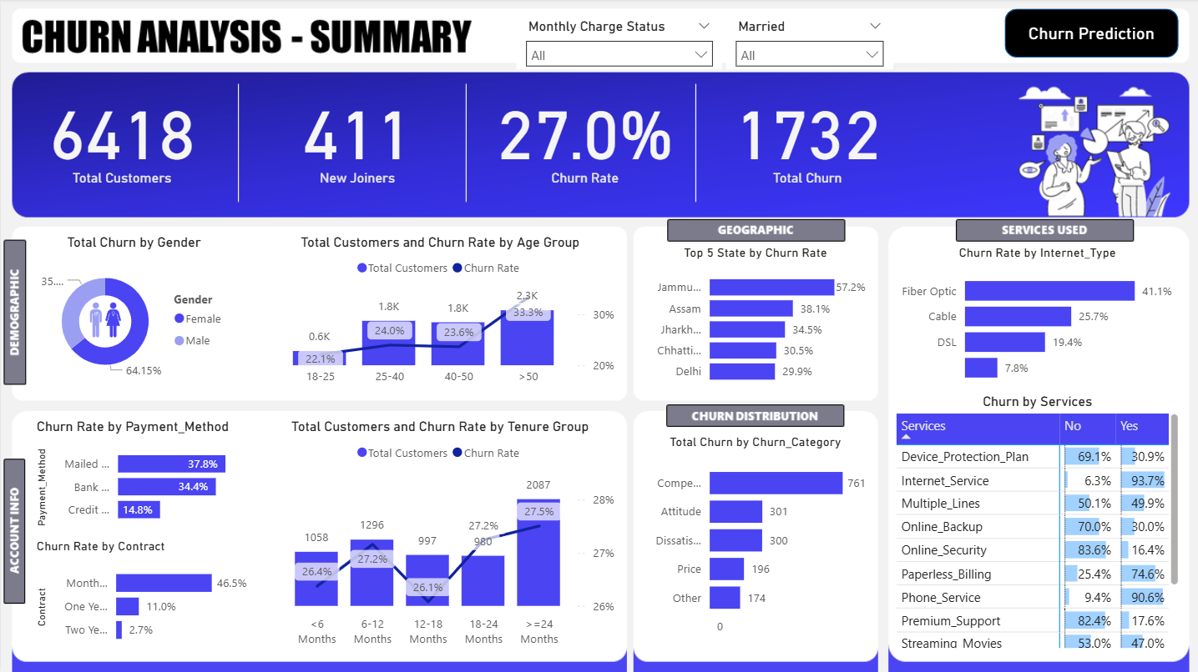

Slide 9

Machine
Learning Model
Used Random Forest Classifier to predict churn
Accuracy: 84%
Performed Label Encoding, Train-Test split, and Feature Importance analysis
Saved model using joblib and used outputs in Power BI
Page
09

Slide 10
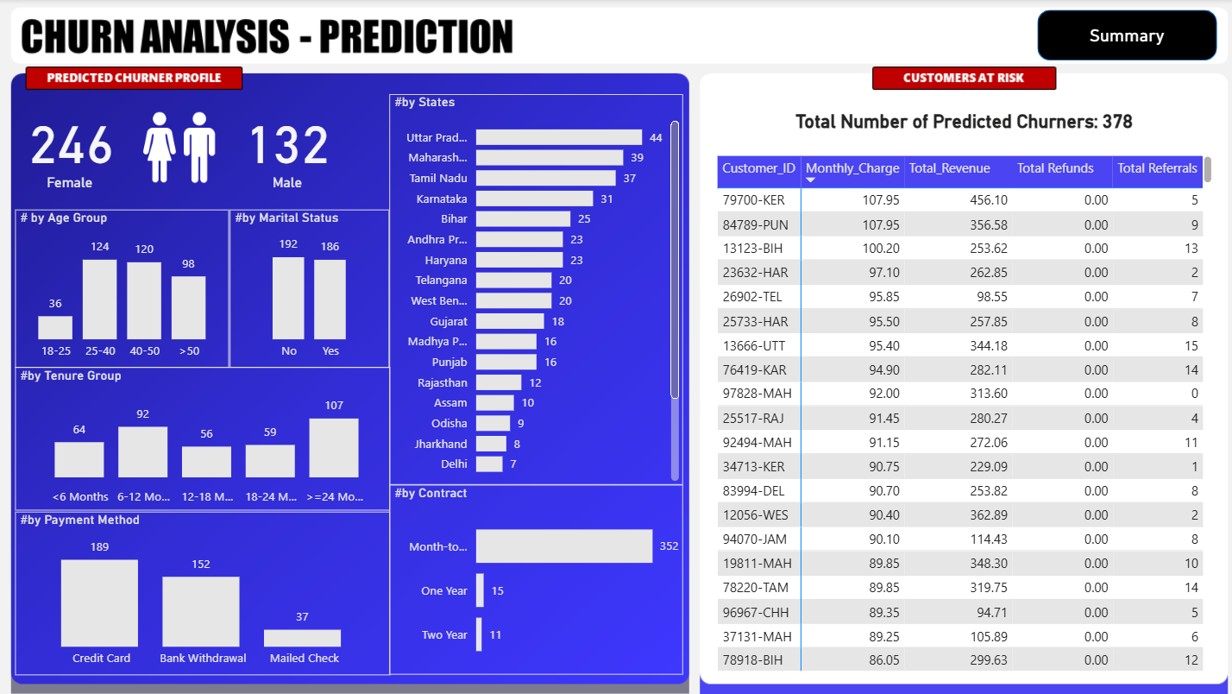

Slide 11

Project
Outcomes
Identified top churn drivers: Contract Type, Tenure, Monthly Charges
Built dual Power BI dashboards with actionable insights
Delivered 84% accurate churn prediction model
Enabled strategic targeting of high-risk customers for retention
Page
11

Slide 12
Thank
You.
piyush.upadhyay030@gmail.com
Page
12

